Slide 1
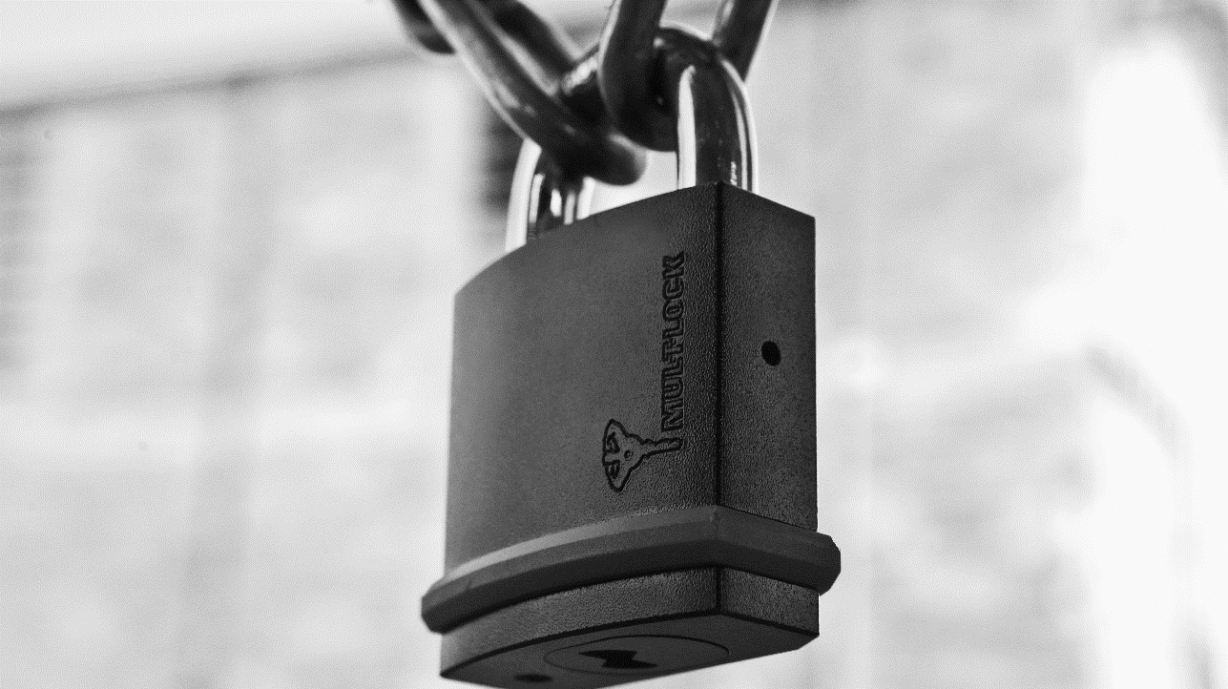

Padlocks 2021
Part of ASSA ABLOY

Slide 2
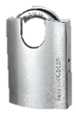
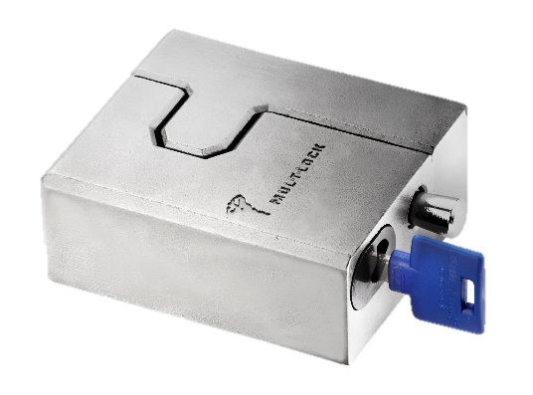
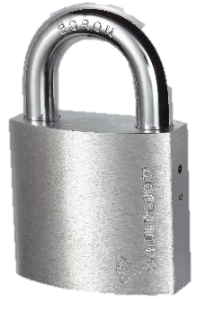
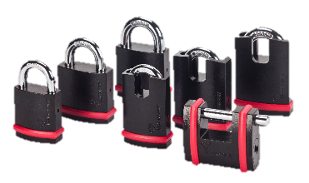
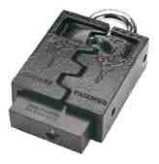
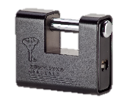
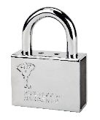
Padlock Portfolio
G Series - 1998
Diamond (new)
C Series - 1986
NE Series - 2015

Slide 3
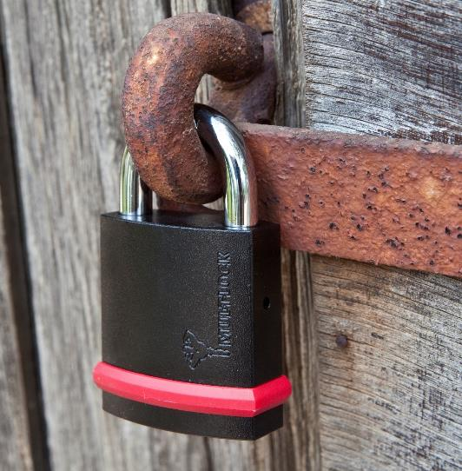
NE - High Security Padlock
Design for maximum efficiency and security
Case hardened solid steel body
Black electrophoretic plating for maximum resistance against corrosion
Excellent resistance against physical attack
Ball bearing locking with key retaining function
Dust shutter for high durability in hard weather and environment conditions
Bumper for exterior surface protection
Notes:
Maximum efficiency and security
Case hardened solid steel bodies Black Electrophoretic plating.
Excellent resistance against physical attack
Maximum resistance against corrosion
Ball bearing locking with key retaining function.
Dust shutter for maximum resistance against weather and environment conditions - Reliable function in all conditions
Cost-effectiveness versus security level
Various of high security level: EN 12320 - Gr 3,4,5,6,
Adjusted features according application with highly affordable price
MTL exterior design recognition
Bumper for exterior surface protection.
User friendly service
Using the same internal parts with minor changes (Shackle, body and ball bearing)

Slide 4
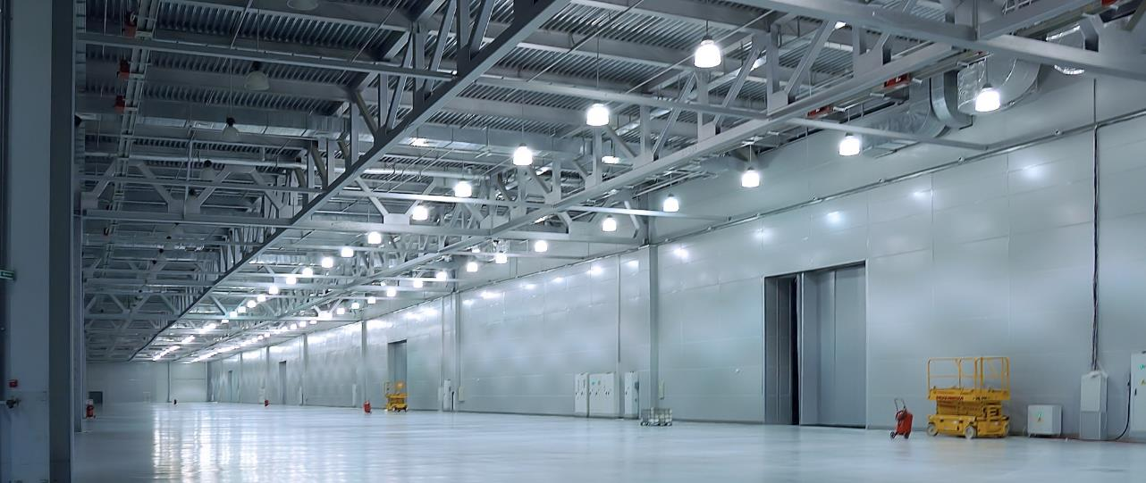
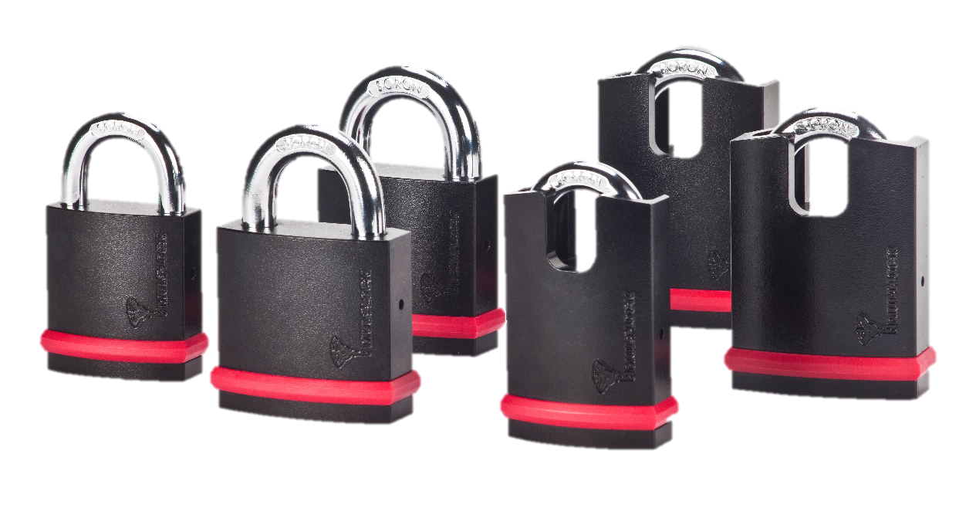
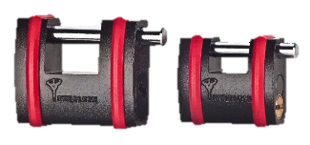
NE Series
10 completely new models
8 models with shackle
2 sliding bolt models
Notes:
Excellent resistance against physical attack

Slide 5




Target Market Segments
High security protection for properties and assets
as you expand your revenue opportunities
Offices
Retail
Cargo
SMB
Construction
Home
Education

Slide 6
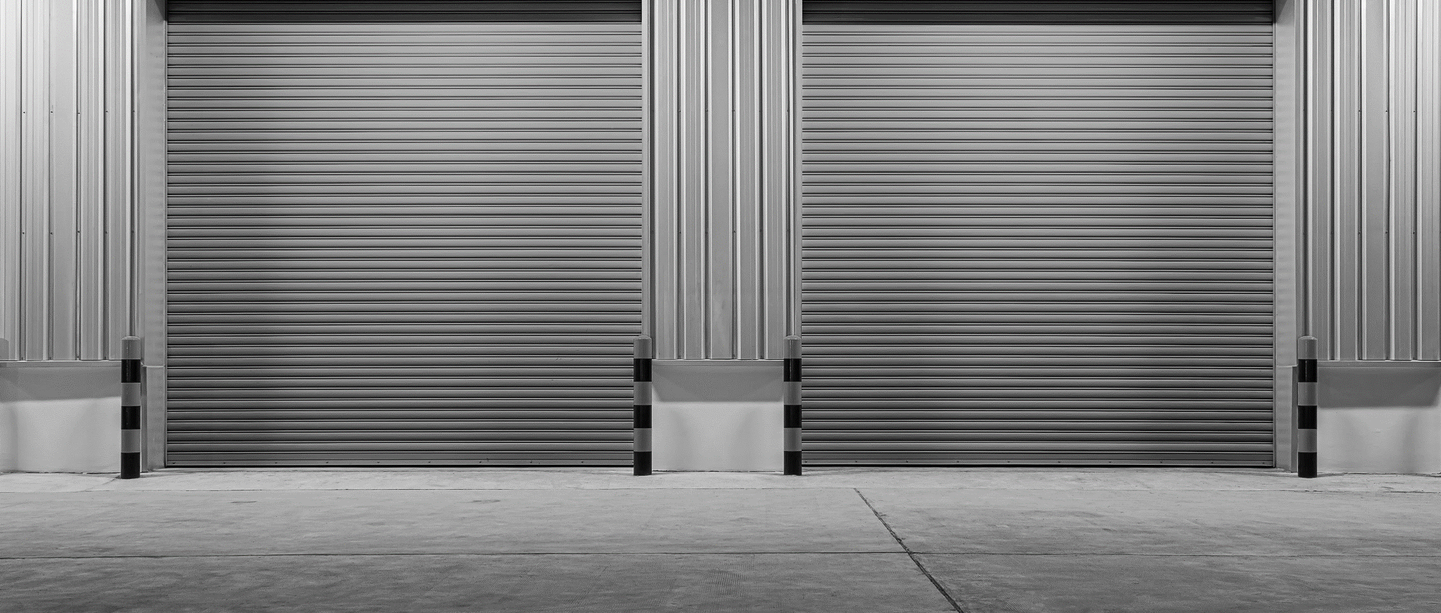
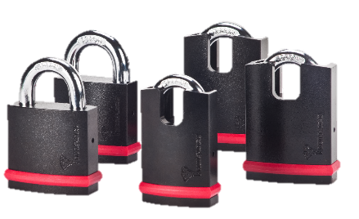
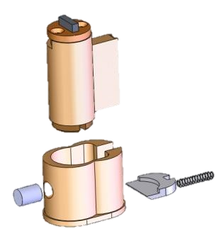
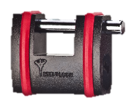
NE Model Series
EN 12320 GR 4, 5, 6.
Hardened steel body
Hardened Boron Alloy Shackle
Drilling protection - Hardened cylinder protector
High corrosion resistance
Dust protection.
Shackle Diameter : 10, 12, 14 mm
Sliding Bolt Diameter : 12 mm
NE 10L/H, NE 12L/H, NE14L/H, SBNE 12 Models
Notes:
Excellent resistance against physical attack

Slide 7
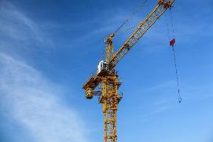
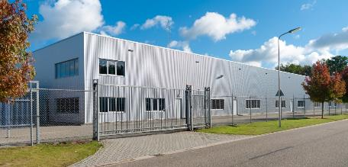

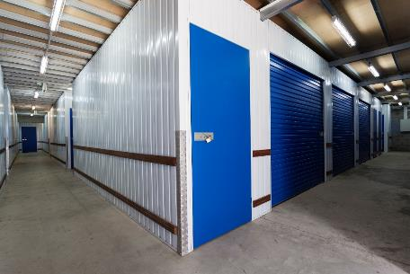

Optional Applications for the NE Models
Gates and doors
Warehouses
Industrial and commercial sites
Security and safety sensitive sites as power stations
Construction equipment
Agriculture equipment
Trailers
Notes:
Heavy duty padlock with Extra security, hardened body and boron shackle drill resistant with high corrosion resistance for extreme security requests as:

Slide 8
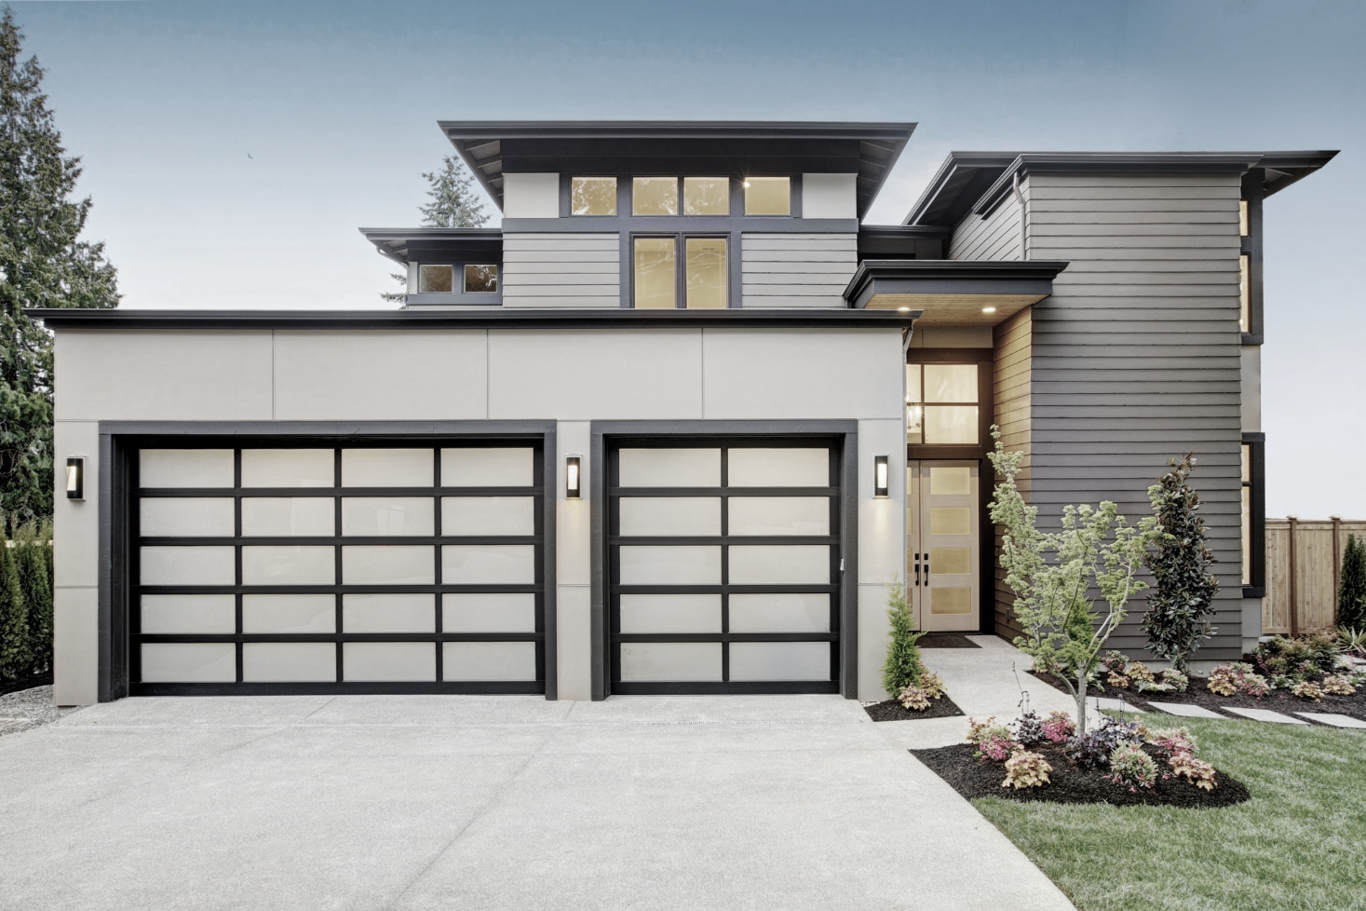
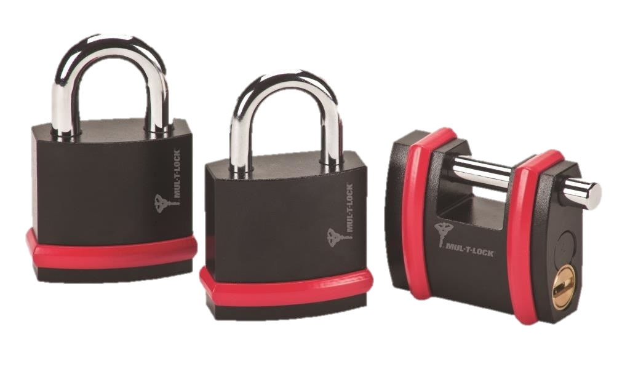
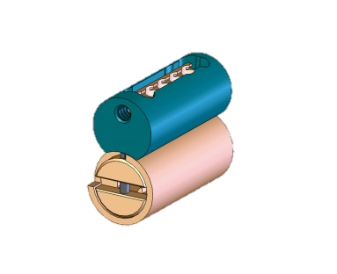
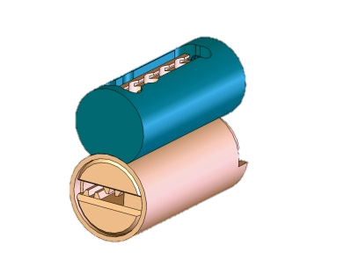
NEG Series
EN 12320 GR 3
Steel Body
Hardened Boron Alloy Shackle
High corrosion resistance
Shackle Diameter : 8, 10 mm
Sliding bolt Diameter : 10 mm
NE 8G, NE 10G, SBNE 10 Models

Slide 9




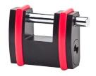
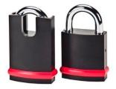
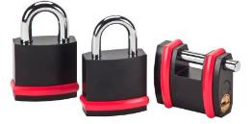
EN 12320 Grading (2012 version)
 | NE14H NE14L | Security Grade 6
 | NE12H NE12L SBNE12 | Security Grade 5
 | NE10L NE10H | Security Grade 4
 | NE8G, NE10G, SBNE10 | Security Grade 3
6 | 4 | 1 | 1
5 | 4 | 1 | 1
4 | 4 | 1 | 1
3 | 4 | 1 | 1

Slide 10
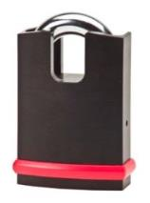
What Makes Mul-T-Lock’s NE series So Effective?
Excellent physical attack resistance
Maximum corrosion resistance
Reliable function
Simple efficient service
Comply with international standards
Cost effective
Versatile application and platform
Notes:
Maximum efficiency and security
Case hardened solid steel bodies Black Electrophoretic plating.
Excellent resistance against physical attack
Maximum resistance against corrosion
Ball bearing locking with key retaining function.
Dust shutter for maximum resistance against weather and environment conditions - Reliable function in all conditions
Cost-effectiveness versus security level
Various of high security level: EN 12320 - Gr 3,4,5,6,
Adjusted features according application with highly affordable price
MTL exterior design recognition
Bumper for exterior surface protection.
User friendly service
Using the same internal parts with minor changes (Shackle, body and ball bearing)
Excellent resistance against physical attack
Maximum resistance against corrosion
Reliable function in all conditions
Meet the requirements of EN 12320 padlock standard and the additional international standards
Simple efficient service – many identical components
Versatile platform available
: KIK profile.
Interactive+, MT5®, Cliq platforms
Keyed different, keyed alike
Master keyed

Slide 11

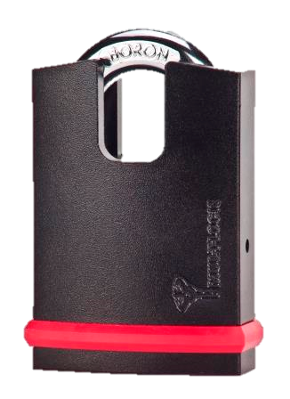
Secure. Efficient. Reliable
Design for maximum efficiency and security
Focus to correlate performance – product feature and quality
Cost-effectiveness versus security level
Mul-T-Lock exterior design recognition
User friendly service
Notes:
Maximum efficiency and security
Case hardened solid steel bodies Black Electrophoretic plating.
Excellent resistance against physical attack
Maximum resistance against corrosion
Ball bearing locking with key retaining function.
Dust shutter for maximum resistance against weather and environment conditions - Reliable function in all conditions
Cost-effectiveness versus security level
Various of high security level: EN 12320 - Gr 3,4,5,6,
Adjusted features according application with highly affordable price
MTL exterior design recognition
Bumper for exterior surface protection.
User friendly service
Using the same internal parts with minor changes (Shackle, body and ball bearing)

Slide 12
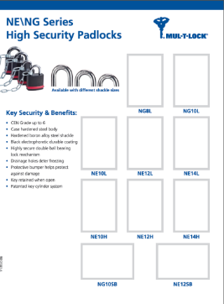
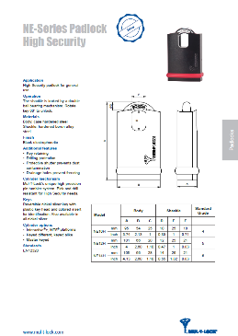
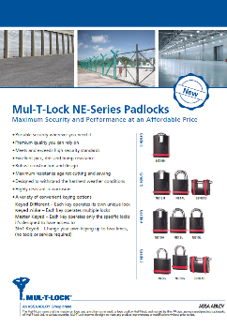
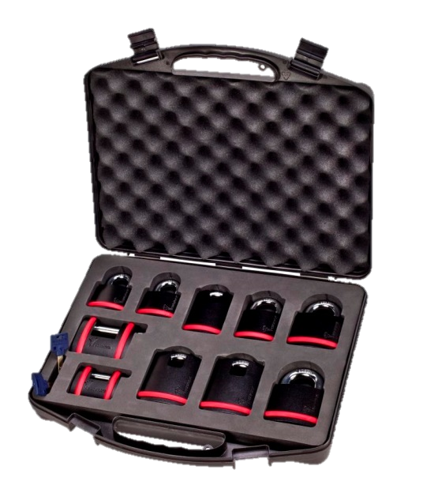
Marketing Materials
Brochures
Show case
Catalog
Padlock display - POS
Technical Manual

Slide 13
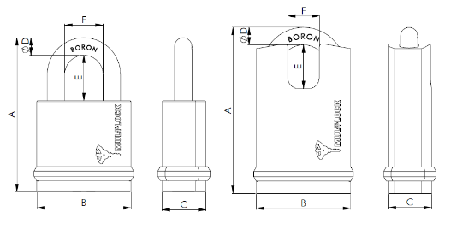
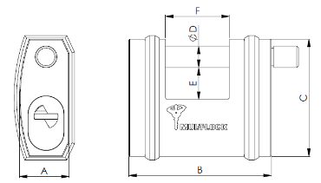
Dimensions
A
B
C
D
E
F
TYP
87
54
25
8
27
24
NE8G
88
54
25
10
26
22
NE10G
95
54
25
10
25
28
NE10L
95
54
25
10
25
18
NE10H
101
66
28
12
25
30
NE12L
101
66
28
12
25
21
NE12H
105
66
28
14
26
32
NE14L
105
66
28
14
26
21
NE14H
28
80
66
12
18
36
SBNE12
25
64
54
10
9
26
SBNE10

Slide 14
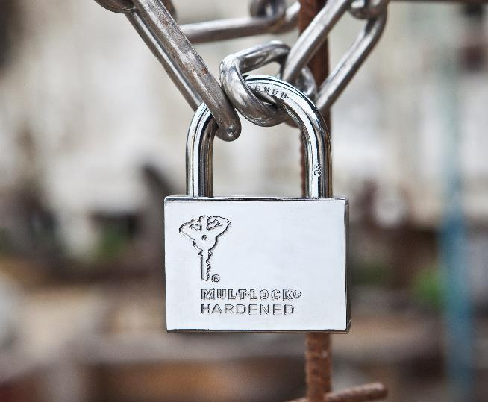
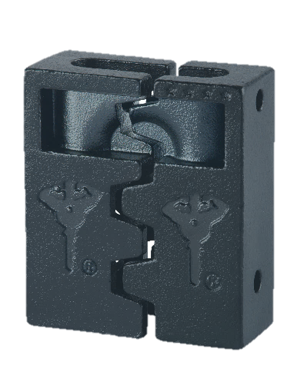
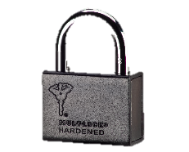
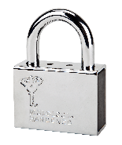
C Series Padlocks
Case hardened steel shell
Chrome plated boron steel shackle
Cut & saw resistant
Hasp option for C 10,13,16
Shackel protector options
Finishes – Chrome-Nickel or Black electrophoretic plating
EN 12320 grade 2,3,4,5
All cylinder platforms & key blanks

Slide 15

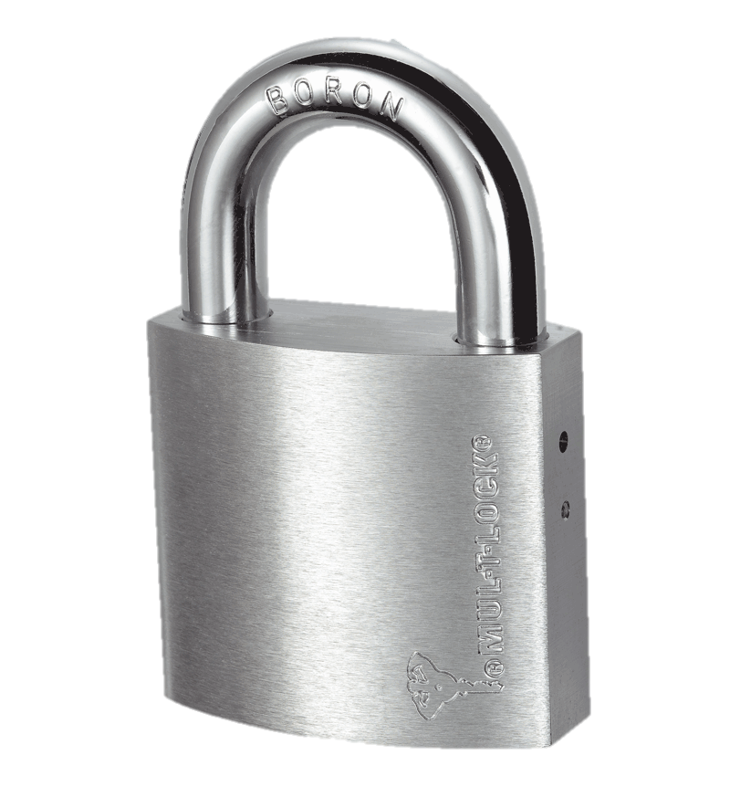
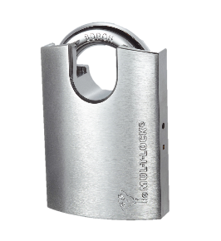
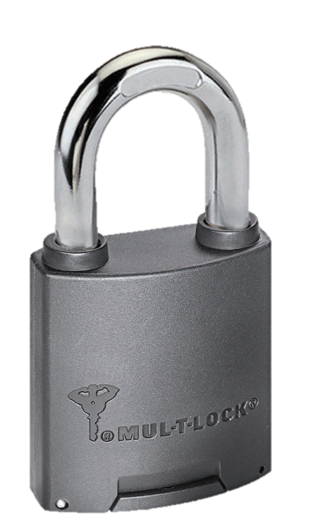
G Series Padlocks
Satin Chrome-Nickel plated brass body
Double ball bearing mechanism
Chrome Plated hardened boron steel shackle
Cut & Saw resistant
Optional weather & corrosion protection
EN 12320 - grade 3

Slide 16
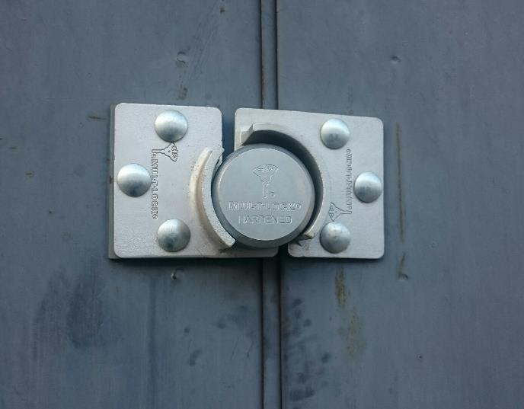
Hockey Puck Padlock and Hasp
Industrial and commercial use
Installation with bolts
Suitable for different Hasp types
Operated by KIK cylinder

Slide 17
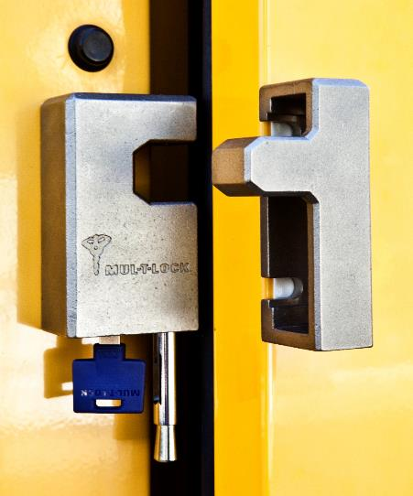
Mul-T-Lock NEW DIAMOND Hasplock
Stainless Steel housing
Security level: EN 12320 Gr 5
Durable and Reliable
Highest weather resistance
Environmentally safer
Available with key retaining or Non key retaining

Slide 18
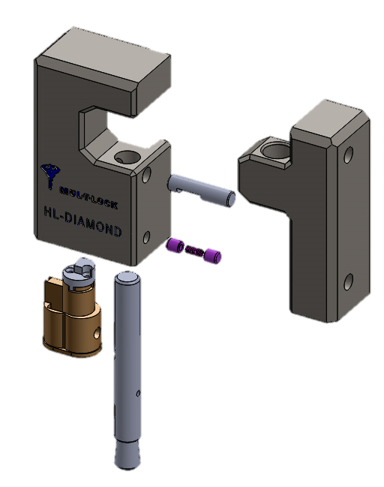
Hasplock DIAMOND – Technical description
Improved mechanical design
Non Removable Locking Bolt
Hardened steel Cr-Ni Plating Locking Bolt
Cylinder drilling protection
Same protector and cylinder as NE padlock
Lock body
Counter body
Locking Pin
Bolt Holder
Cylinder & protector
Locking Bolt

Slide 19
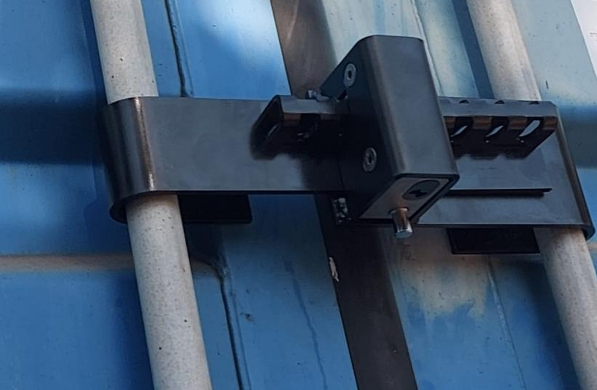
Container Lock
Based on EN 12320 Gr. 5 DIAMOND Hasplock
Suitable for moving or stationary containers.
Adjustable arms clearance : 300-480 mm
Industrial or transportation use.
Maximum physical security.

Slide 20


Thank you

