Slide 1


Belo Matyko | July 2021
Locks Portfolio

Slide 2
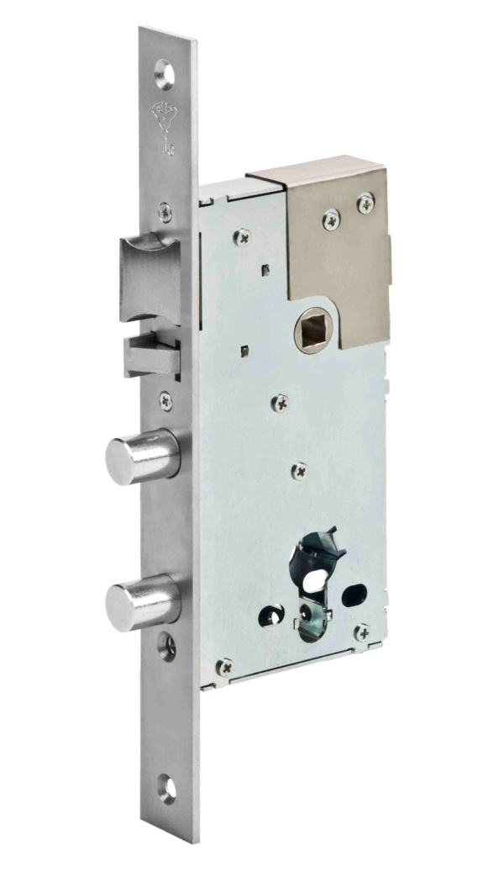
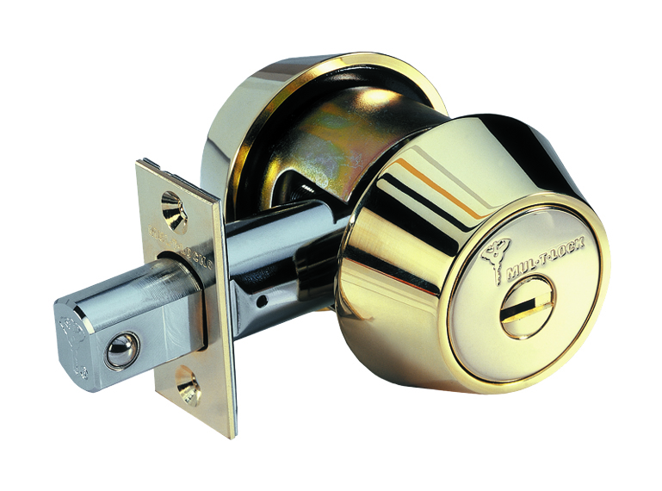
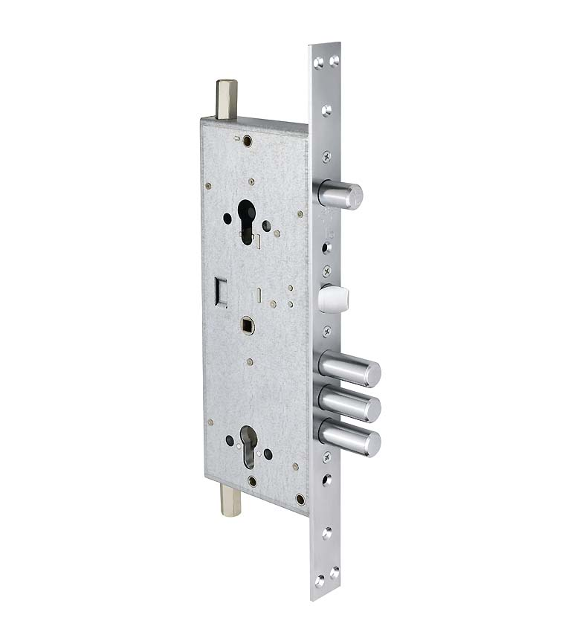
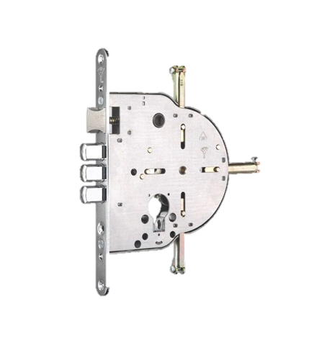
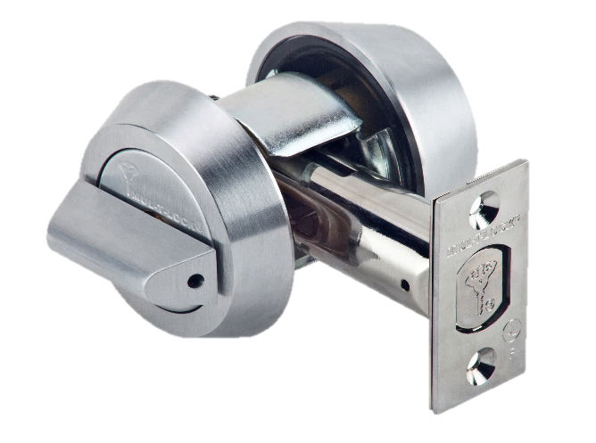
Product Categories
OEM Solutions
Locksets

Slide 3
OEM Solutions
4-way-locks
Hardware
MPL 415G
Lock cases
Other MPL
Lock Kits

Slide 4
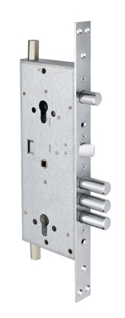
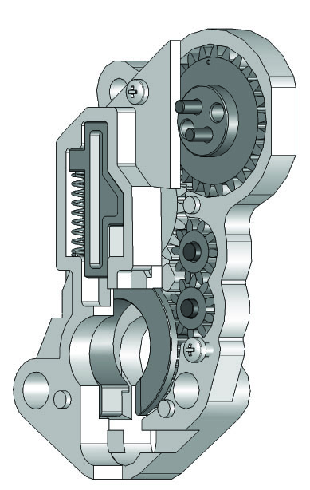
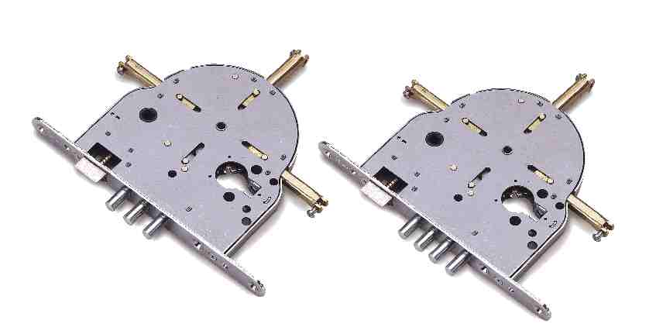
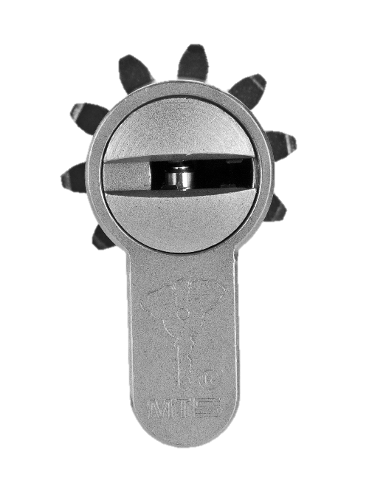
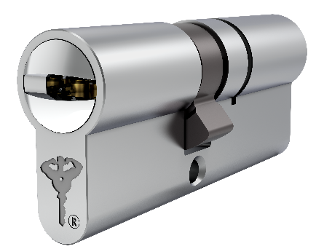
Gear Locks (easy/smooth steering lock mechanism)
4-way-locks
MPL415G
cogwheel cylinder- cogwheel mechanism in the lock
cam cylinder- cogwheel mechanism in the lock

Slide 5
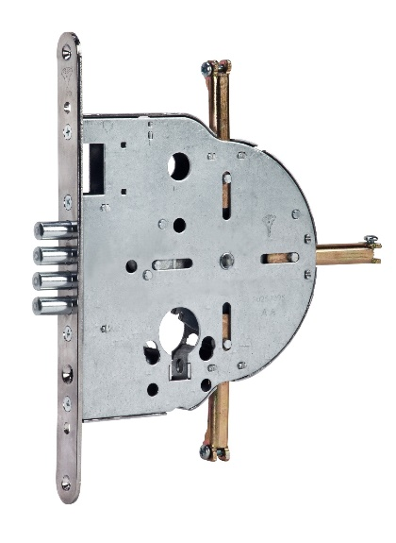
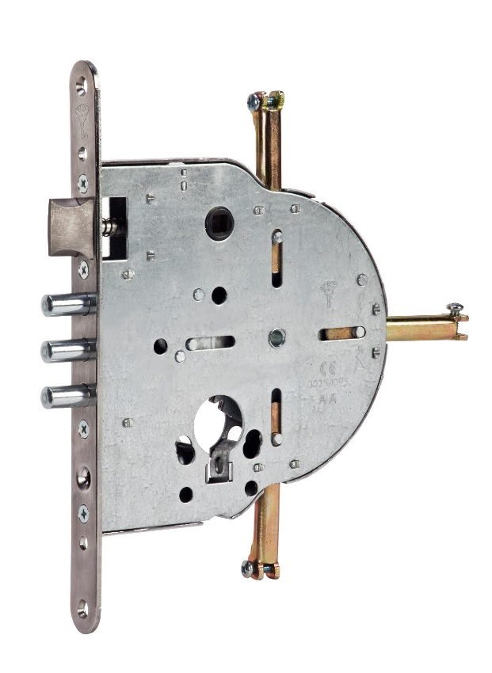
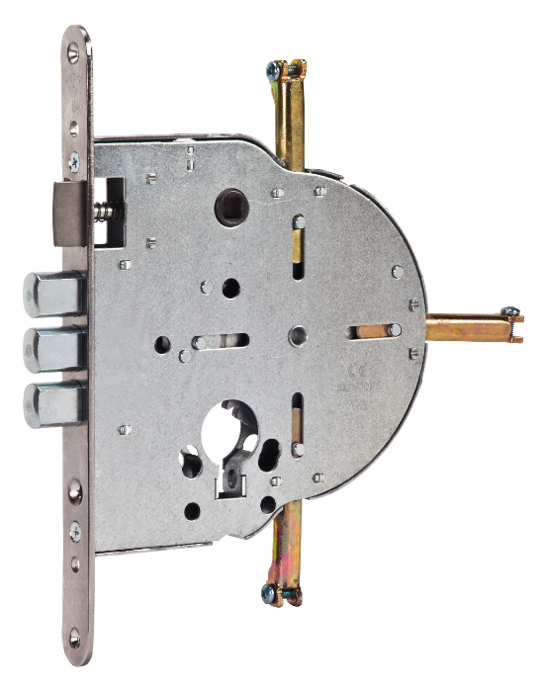
4-way-locks - 235,240,250,602
Use: Steel doors
Characteristics:
  Activated by cogwheel cylinder, Euro or Swiss profile
  Cogwheel mechanism- one turn
  10mm-13mm, Double D locking bolts, 20 mm bolt throw
  Fire rated
  En 12209 class 3-5 rated
  En 1627-1630 class 3 rated
  Need special hardware
  Accessories available

Slide 6
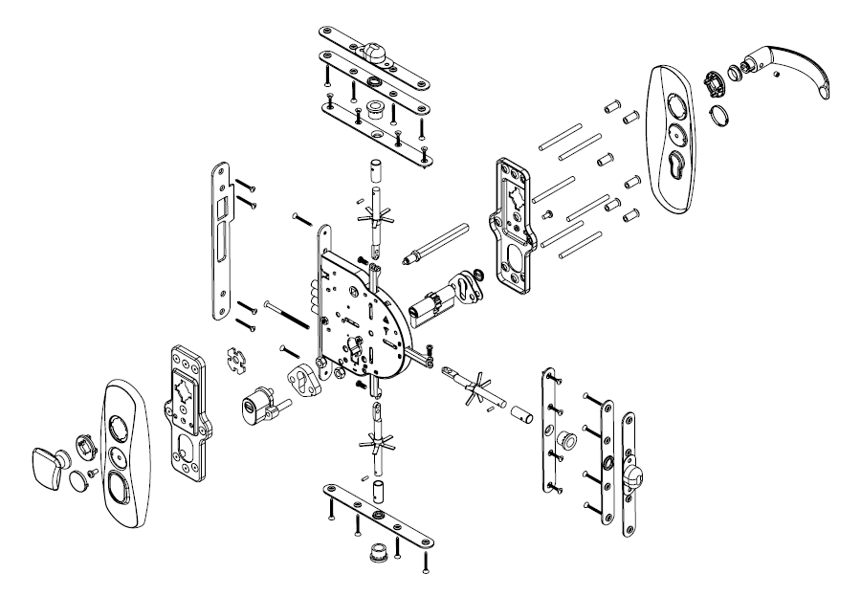
Lock Kit for Multipoint Locks

Slide 7
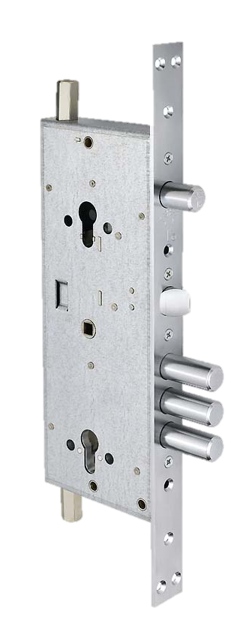
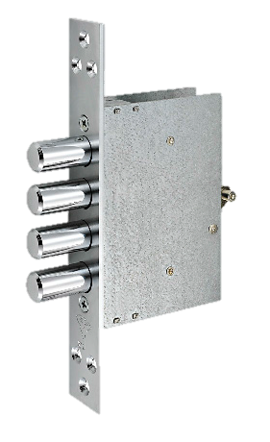
MPL 415G – Multipoint lock
Use: Steel doors
Characteristics:
  Double cylinder Lock
  Activated by cam cylinders, Euro profile
  Central Cogwheel mechanism- double turn
  Bolt throw 41 mm,
  3 bolts 18 mm Dia.
  Upper mechanism- double turn
  25 mm one bolt 18mm Dia
  Individual geometrical locking on each of the locking directions
  Lock kit available

Slide 8

MPL 415G – multipoint lock set
Includes:
  Branded boxes
  Central lock
  Side locks- 2 pcs
  Adjustable bars for 1.92-2.12 door height
  Striking plates and screws
  Upper and lover striking boxes
  HS cylinder escutcheons - different finishes
  Cylinders – optionally!

Slide 9
OTHER MULTIPOINT LOCKS

Slide 10
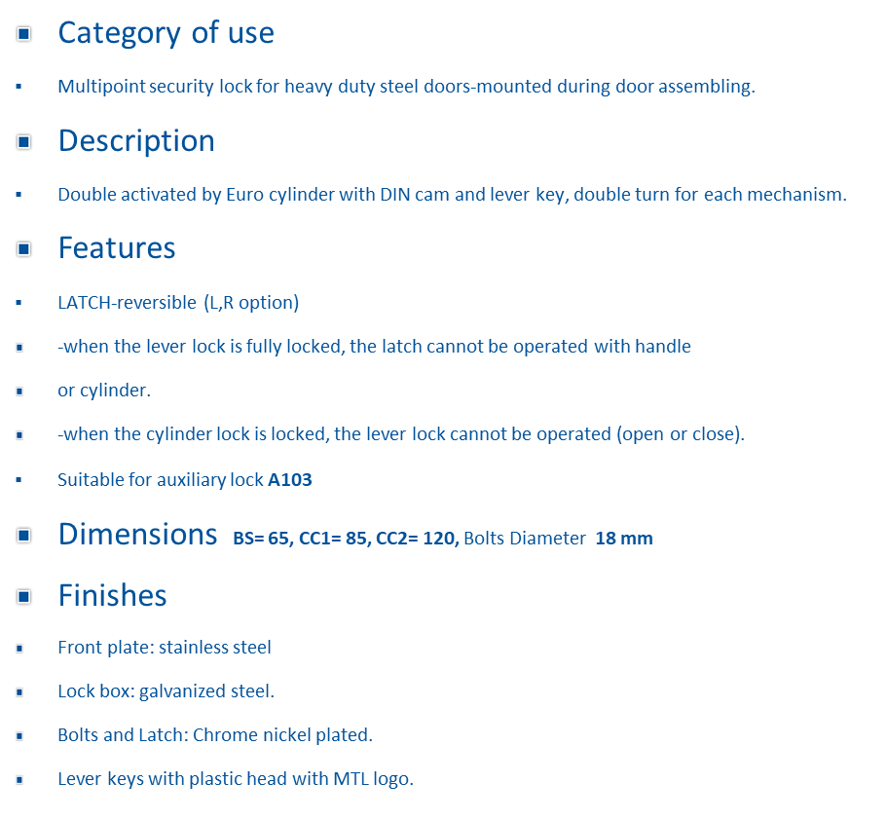
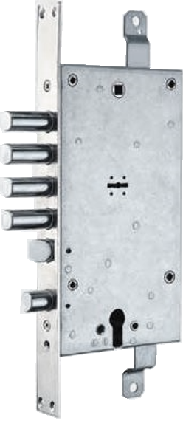
Multipoint Lock 204A

Slide 11
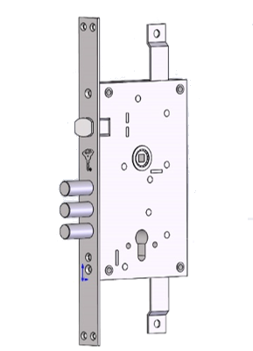
Multipoint Lock 352R
Category of use
Multipoint security lock for heavy duty steel doors.
Description
Activated by Euro cylinder with DIN cam mechanism.
Double Turn dead bolt function 17/35 mm
Features
LATCH-reversible (L,R option)
Suitable for auxiliary lock A103
Dimensions BS= 65, CC= 85, Bolts Diameter 16 mm X 3
Finishes
Front plate: Chrome-Nickel plated steel
Lock box: galvanized steel.
Bolts and Latch: Chrome-Nickel plated steel

Slide 12
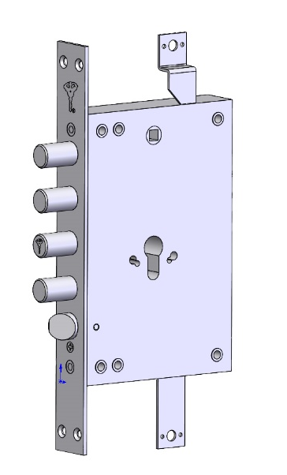
Multipoint Lock 104A
Category of use
Multipoint security lock for heavy duty steel doors-mounted during door assembling.
Description
Activated by Euro cylinder with DIN cam. Double rotation of the cylinder 29 (15+14) mm stroke.
Features
LATCH-reversible (L,R option)
When the bolts are in closed position the latch is disable with the handle.
Suitable for auxiliary lock A103
Dimensions BS= 65, CC1= 85, Bolts Diameter 18 mm
Finishes
Front plate: stainless steel
Lock box: galvanized steel.
Bolts and Latch: Chrome Nickel plated.

Slide 13
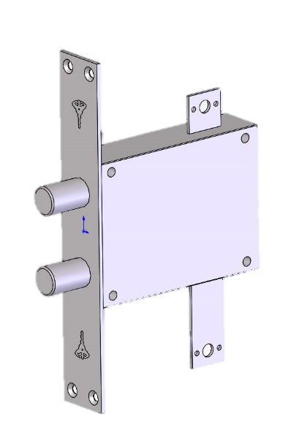
Auxiliary lock A103
Suitable for general use as auxiliary lock.
352R
204A
104A
Double bolt with 18 mm diameter
FUNCTION:
BOLT STROKE 28mm
VERTICAL DROP 20+1.0 mm
LOCK FINISH:
Front plate: stainless steel
Lock box: galvanized steel.
Bolts and Latch: Chrome nickel plated.

Slide 14
LOCK CASES

Slide 15
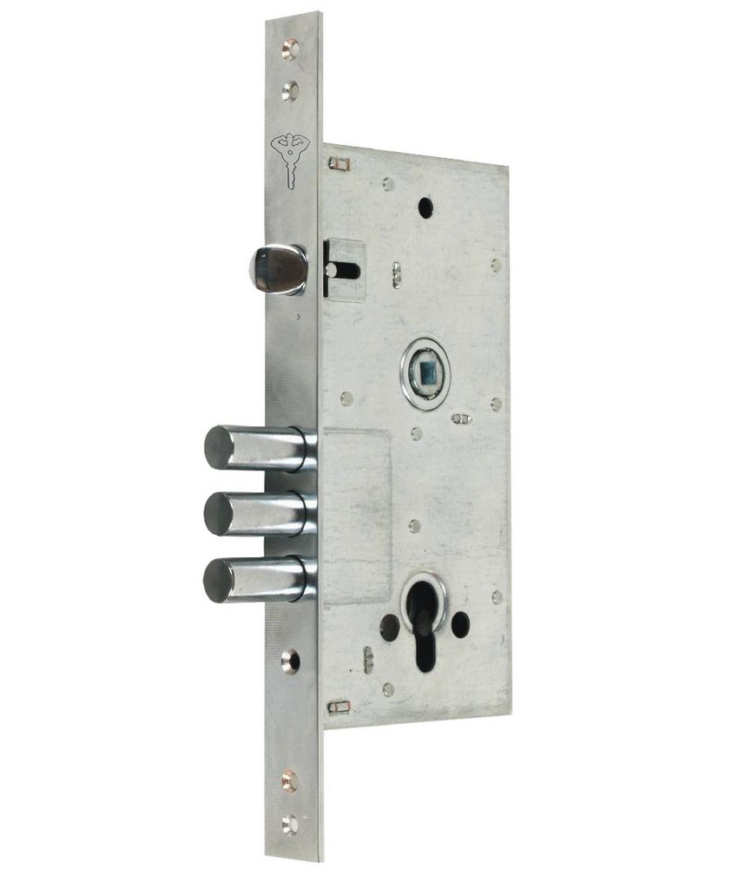
Mortise Lock 354M
Category of use
Security lock for heavy duty steel doors.
Description
Activated by Euro cylinder with DIN cam. Double rotation of the cylinder 35 (17/18) mm stroke.
Features
LATCH-reversible (L,R option)
Handle spindle with ball bearing
Dimensions BS= 60, CC= 85, Bolts Diameter 16mm x 3
Finishes
Front plate: Chrome nickel plated
Lock box: galvanized steel.
Bolts and Latch: Chrome nickel plated.

Slide 16
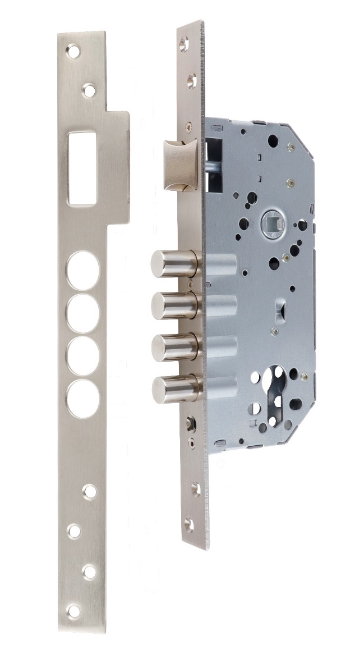
Mortise lock 277
Category of use
Security lock for all doors.
Description
Activated by Euro cylinder with DIN cam. Double rotation of the cylinder 20 (10/10) mm stroke.
Features
LATCH-reversible (L,R option)
Dimensions BS= 50, CC= 85, Bolts Diameter 12mm x 4
Finishes
Front plate: Satin Nickel plated
Lock box: galvanized steel.
Bolts and Latch: Satin Nickel plated .

Slide 17
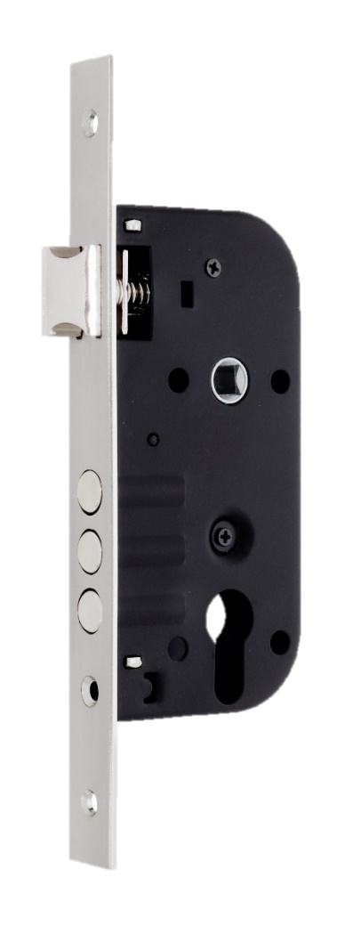
Mortise lock case 310-45A
Category of use
Security lock for all doors.
Description
Activated by Euro cylinder with DIN cam. Double rotation of the cylinder 20 (10/10) mm stroke.
Features
LATCH-reversible (L,R option)
Dimensions BS= 45, CC= 70, Bolts Diameter 14mm x 3
Finishes
Front plate: Chrome Nickel plated
Lock box: Black painted steel.
Bolts and Latch: Chrome Nickel plated .

Slide 18
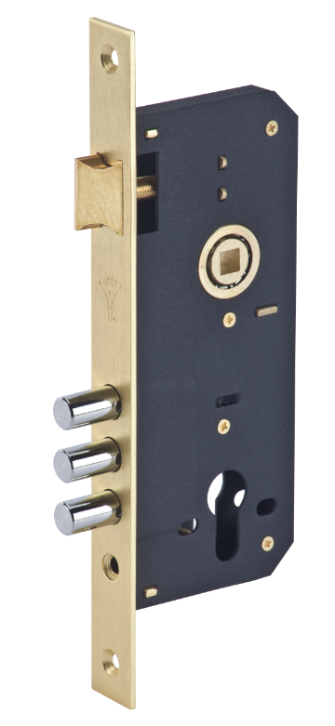
Lock 204S
Category of use
Security lock for all doors.
Description
Activated by Euro cylinder with DIN cam. Double rotation of the cylinder 20 (10/10) mm stroke.
Features
LATCH-reversible (L,R option)
Handle spindle with ball bearing
Dimensions BS= 45, CC= 85, Bolts Diameter 12mm x 3
Finishes
Front plate and Latch : Shine brass plated
Lock box: Black painted steel.
Bolts : Chrome Nickel plated .

Slide 19
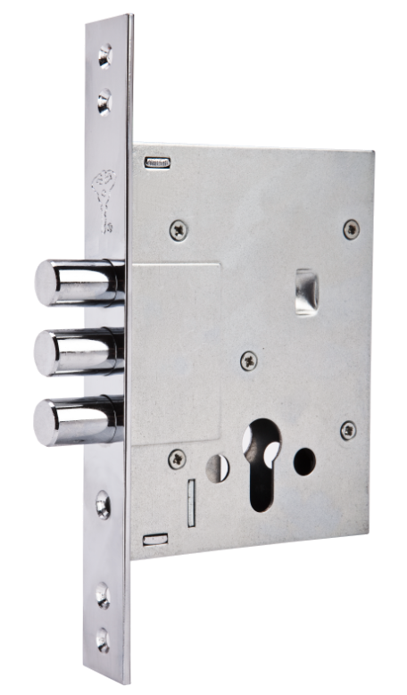
Lock 353P
Category of use
Auxiliary lock for steel doors.
Without latch and Handle
Description
Activated by Euro cylinder with DIN cam. Double rotation of the cylinder 35 (18/17) mm stroke.
Dimensions BS= 60, Bolts Diameter 16mm x 3
Finishes
Front plate: Chrome Nickel plated
Lock box: Black painted steel.
Bolts: Chrome Nickel plated .

Slide 20
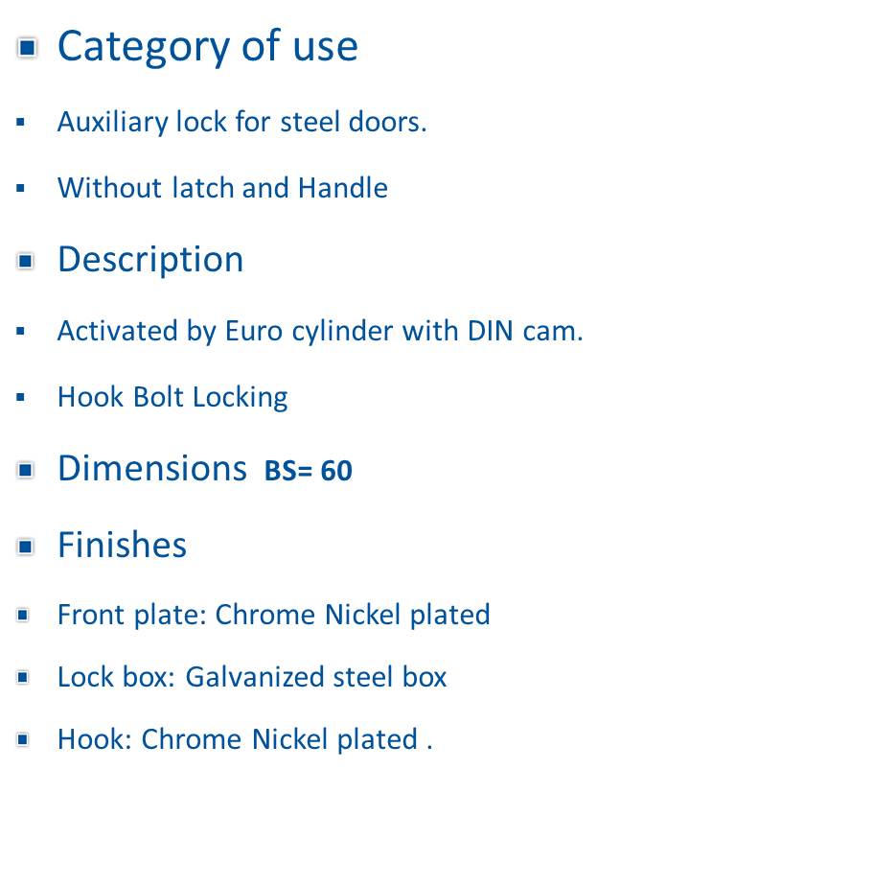
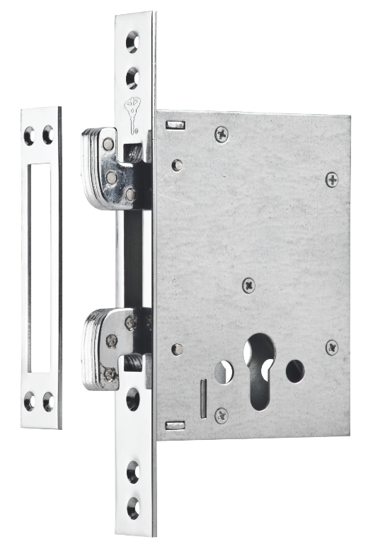
Lock 352K

Slide 21
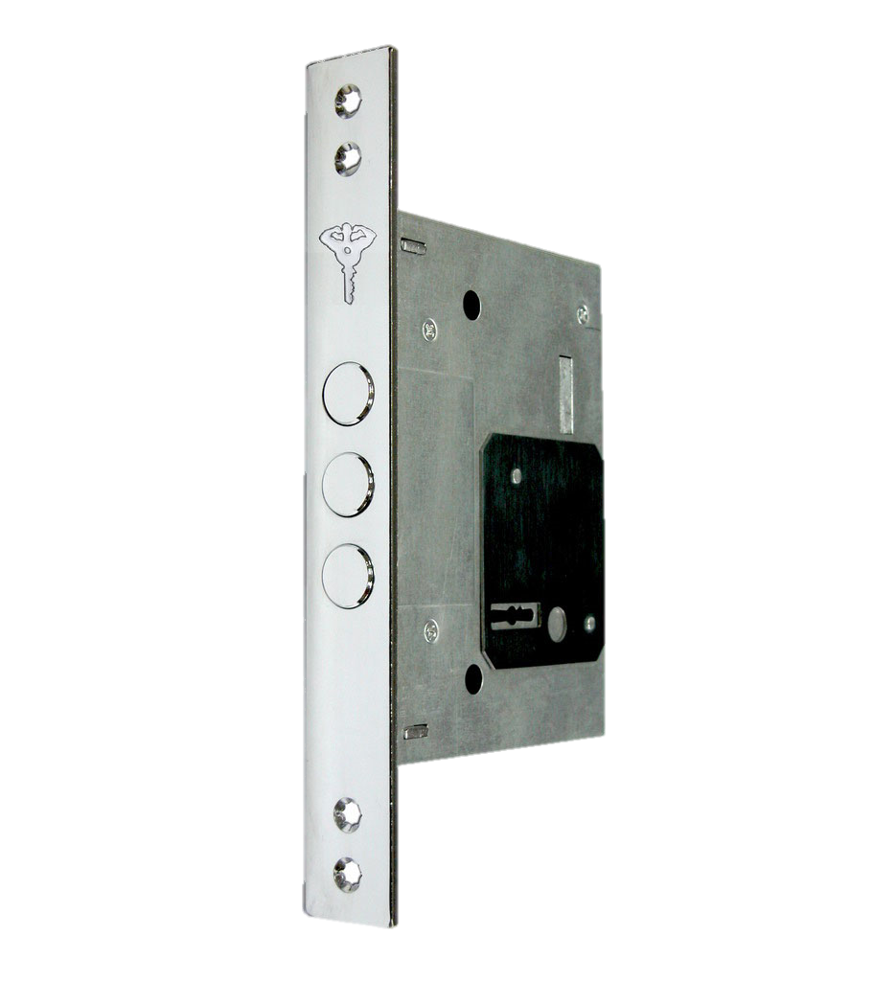
Lock 257 – Security Lever Lock
Category of use
Wood and steel doors
Characteristics:
  Preferred installation as additional lock for reinforcing security level.
  Deadlock mechanism- double turn
  Backset: 60 mm
  Triple round deadbolts: Ø16 mm
  Keyway protective plate hinders drill attacks
  Bolt throw = 18/35 mm
  Keys:3 or 5 double bit keys
  Cr/Ni plated front plate
  Galvanized steel box

Slide 22
HARDWARE

Slide 23
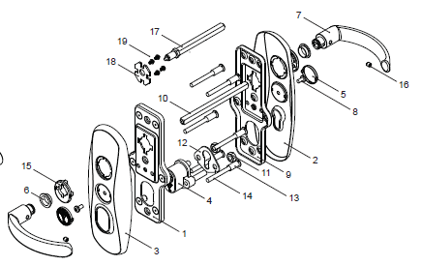
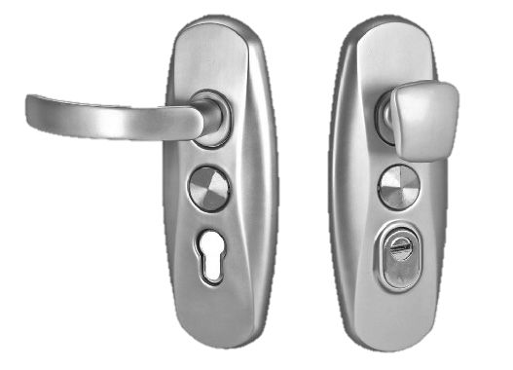
HARDWARE – SH 300
Use : 4-way Locks
Characteristics:
  Suitable for 4-way locks
  CC – 85 / 90 mm
  Friendly installation
  Moving handles and fixed handles versions
  Finishes: gold, nickel brushed and nickel satin

Slide 24
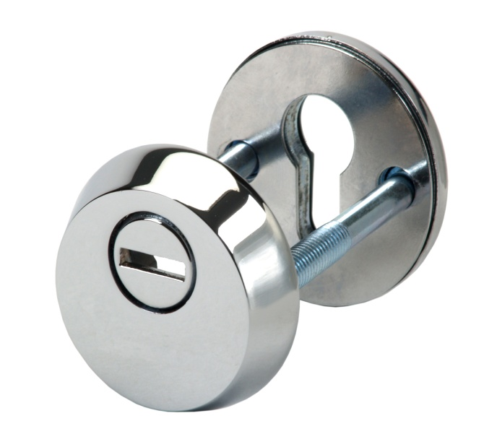
HS Cylinder escutcheons for heavy duty locks
Use: compatible with all Euro profile cylinders and MTL multipoint locks
Characteristics:
  Hardened steel body
  Drill resistant rotating disk
  M8 screws
  Friendly installation
  Suitable for door thickness 50-75 mm
  Finishes: bright/satin chrome, bright brass, brushed nickel

Slide 25
LOCKSETS

Slide 26
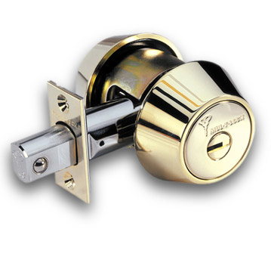
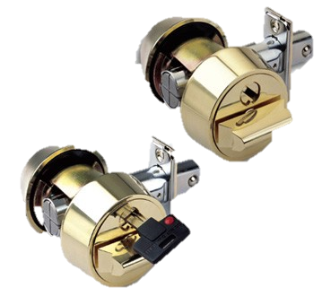
HERCULAR Deadbolt
Use: High-security deadbolt system for commercial and residential doors.
Characteristics:
  Suitable for two backsets, no need for different parts
  Standards and drive-in
  Supplied as standard with 1” (25 mm) throw
  Optional as double or single cylinder
  Thumb turn tail self-adjustable to door thickness
  Option for captive key deadbolt
  Finish: US3, US26, US26D, US5A, US10B6
  UL Grade I rated

Slide 27
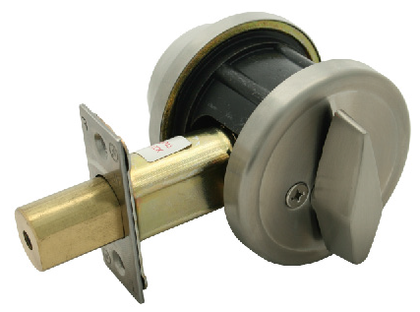
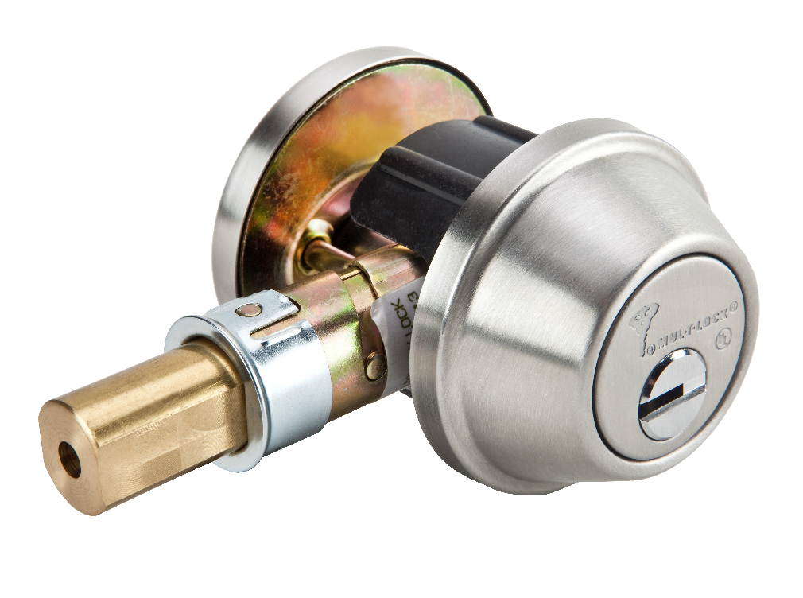
CRONUS Deadbolt
Use: Provide protection for residential and commercial doors.
Characteristics:
  Suitable for two backsets, no need for different parts.
  High security KIK cylinder
  Robust cylinder protector
  Optional as double or single cylinder.
  Reinforced locking bolt
  Door thickness: 1⅜” (35 mm) to 1¾” (45 mm)
  Finish: PVD-Gold, polished stainless steel (US32), brushed stainless steel (US32D).
  UL Grade II rated

Slide 28
DRAWINGS

Slide 29
4-way-locks - 235,240,250,602

Slide 30
Mortise lock 277

Slide 31
Mortise lock case 310-45A

Slide 32
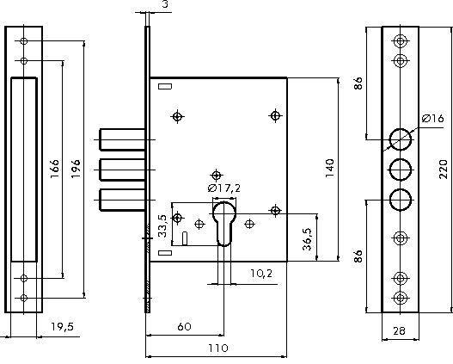
Lock 353P

Slide 33
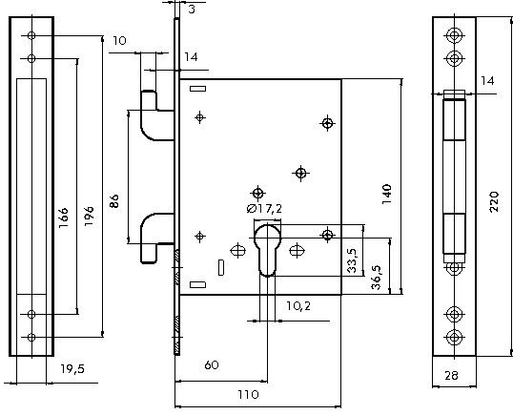
Lock 352K

Slide 34
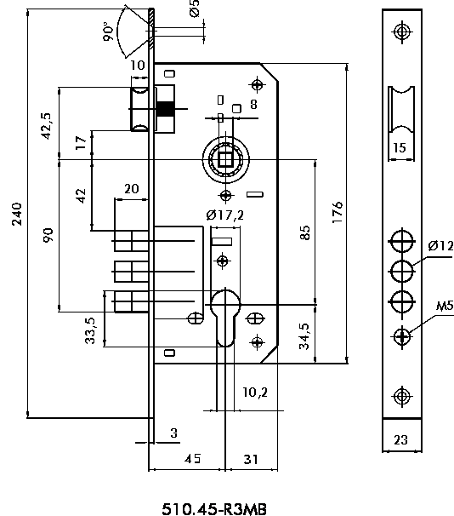
Lock 204S

Slide 35
204A

Slide 36
A103

Slide 37
352R

Slide 38
354M

Slide 39


Thank you

