Slide 1
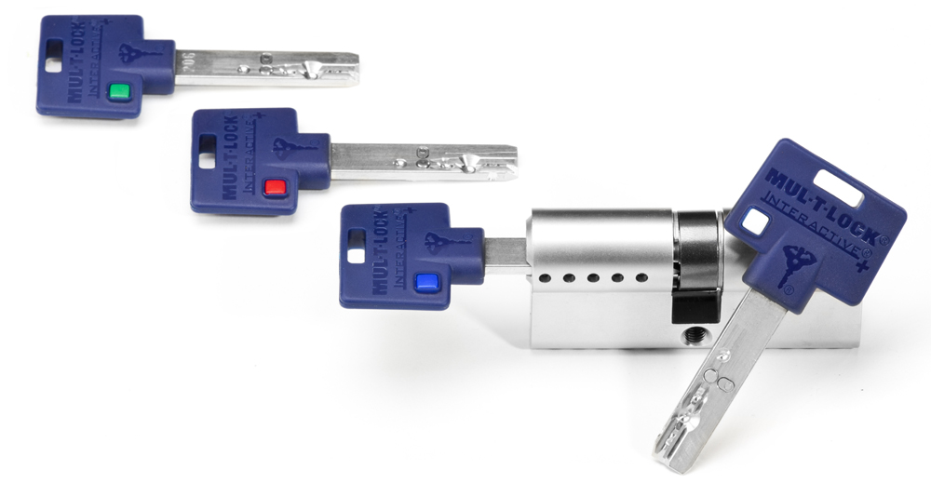
Mul-T-Lock FleX Control cylinder Premises Access On Your Terms
Feb. 2013

Slide 2
FleX Control cylinder
Simple
Convenient
Flexible
Combining convenience with simplicity, the FleX Control cylinder gives you the ability to control entrance access with an easy-to-use, mechanical solution

Slide 3

FleX Control concept
With every FleX Control cylinder, you will receive a set of four color-coded keys
White key – neutral key, for you and anyone you want to have full-time access, such as you and your family members or key employees
Blue key - for those you want to have limited access and at the times you decide
Red and Green keys - allow you to control the blue key holder’s access by rotating the cylinder 90° clock wise or counter clock wise with either the red or green key

Slide 4
FleX Control cylinder benefits
Your Choice – Decide when and for how long you want to provide blue key holders premises access
Extra Efficient – No need to replace the cylinder or collect all keys to prevent access
Cost Effective – No need for additional locks that are often installed to provide access control
Highly Reliable – Field-proven, Mul-T-Lock’s High Security solutions have been protecting people, places and property for close to four decades

Slide 5
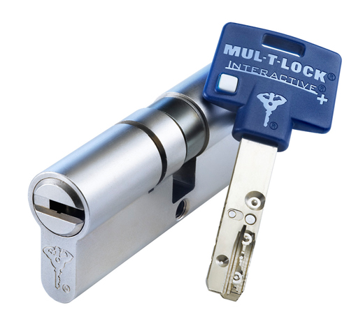
FleX Control cylinder features
Flexible format – Suitable for cylinders of any length
Available in Interactive+ Mul-T-Lock’s telescopic pin platform
Controlled duplication – One duplication card for all keys is supplied, with key duplication available with the card and through authorized Mul-T-Lock locksmiths
Easy installation – As simple as installing any regular cylinder

Slide 6
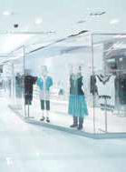
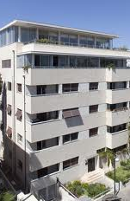
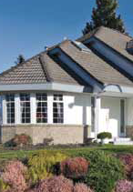

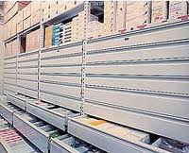
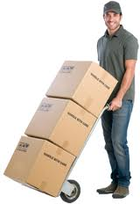
Get control with the FleX Control cylinder
Ideal for use with domestic staff, temporary workers and even full-time employees
Make your shop inaccessible to employees over the weekend
Making a storeroom inaccessible to company employees when sensitive equipment is in storage
Making your home inaccessible to service persons (Housemaid, postman, etc.) over the weekend
Ideal solution for rental housing apartments

Slide 7
Get your own FleX Control cylinder
The application fits products which can operate, after installation, at least 90° CW (clock wise) and CCW (counter clock wise)
Not recommended for use in master key systems
Includes 6 keys as a standard with 2 configurations:
3 white, 1 blue, 1 red, 1 green
2 white, 2 blue, 1 red, 1 green
Supplied with a single magnetic strip card, printed with all key codes
Magnetic strip carries only the white key code

Slide 8

Thank You

